Slide 1
Predicting Poverty with Satellite Images and Machine Learning

Slide 2
Predicting Poverty
International Poverty Line: USD 1.90/day
Estimated at 10.7% World Population (768.5 million) and increasing
Accurate measurements of the economic characteristics of populations critically influence both research and policy
elimination of poverty worldwide is the first of 17 UN Sustainable Development Goals for the year 2030
Lacking economic data for much of the developing world

Slide 3
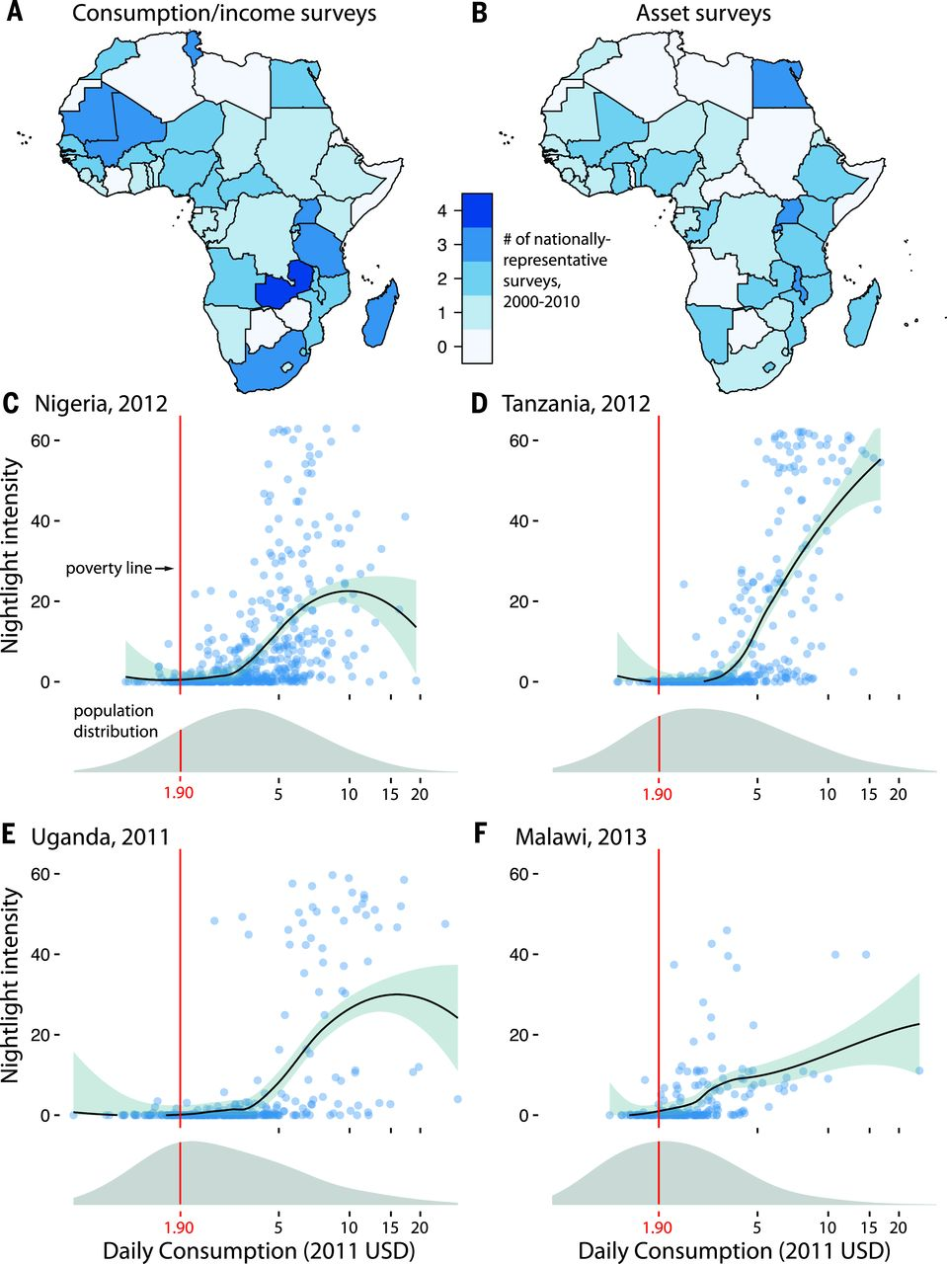
Data Gaps
Nigeria
Uganda
Tanzania
Malawi

Slide 4
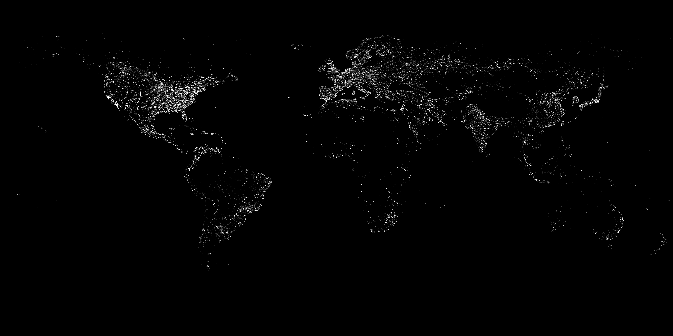
Nightlights

Slide 5
New approach: Transfer Learning
Train CNN to classify general images
Use the CNN to predict nighttime light intensity
Use Survey Data and Ridge Regression to estimate cluster-level expenditures or assets

Slide 6
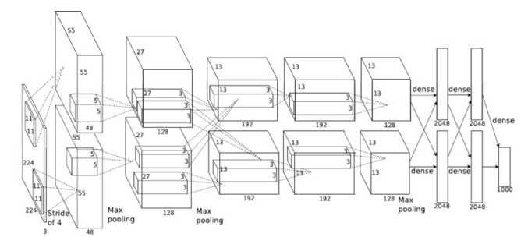
1. Train CNN on ImageNet

Slide 7
2. Transfer learning to predict nightlights

Slide 8
3. Regression

Slide 9
Results

Slide 10
Model Performance

